Slide 1


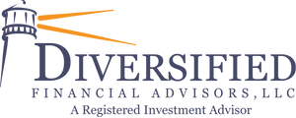
The Future of Retirement Readiness
A 60-minute roundtable for HR leaders exploring the evolving landscape of employee retirement planning.
We'll examine current trends, challenges, and innovative strategies for 2025 and beyond.
by Shannon Lewandoski
Joe Trybula, CFP®, AIF®, CPFA®

Slide 2
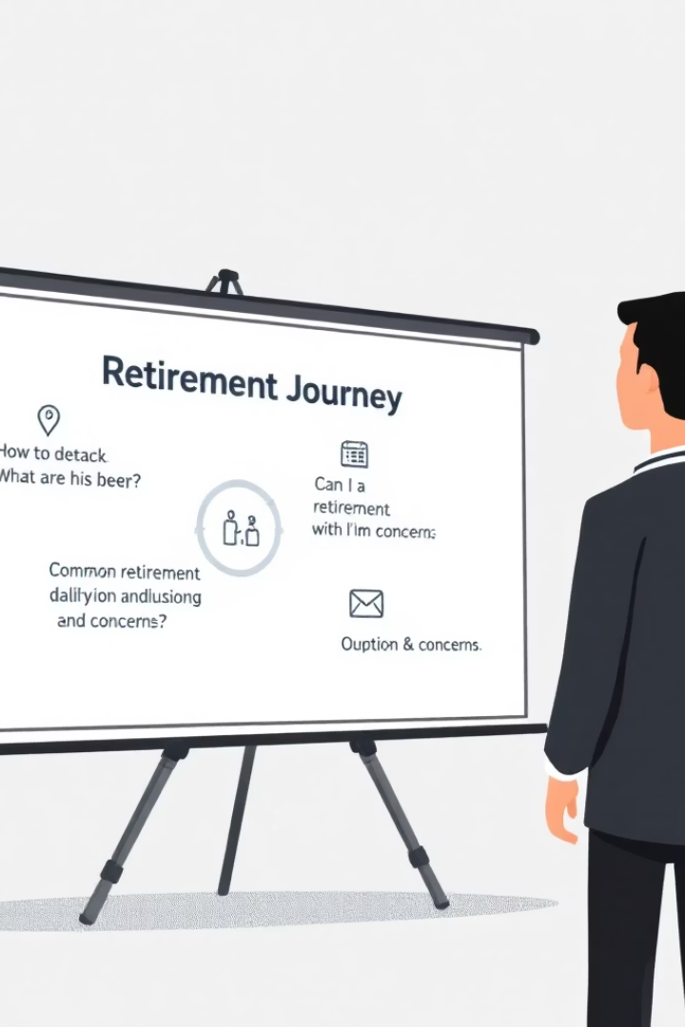



Opening & Connection
Introductions: Speaker & guests
Quick Poll
How many believe your employees are truly on track for retirement?
Common Questions
What 401(k) questions do you hear most frequently from employees?

Slide 3
America's Retirement Reality: 2025 Snapshot
45%
$279,997
8%
Retirement Age
Average Savings
Planning Shift
Workers retiring or planning to retire between ages 60-69
Typical retirement savings by age 65+
Drop in workers planning early retirement (pre-65)
50%
Shortfall Risk
Employees potentially lacking sufficient retirement savings

Slide 4






Optimism vs. Preparedness: The Confidence Gap
High Confidence
Workers express optimism about retirement future
Market Volatility
Economic uncertainty affecting actual retirement security
Delayed Plans
Increasing numbers planning to work past traditional retirement age

Slide 5








Challenges Facing Retirement Readiness
Inflation Concerns
Healthcare Costs
Rising costs eroding purchasing power of retirement savings
Unpredictable medical expenses threatening financial security
Pension Decline
Planning Gaps
Defined benefit plans down to 25% share by 2022
Insufficient financial literacy creating preparation barriers

Slide 6

Group Dialogue: Critical Questions
Saving Barriers
Bridging The Gap
What obstacles prevent your employees from saving adequately for retirement?
How are you helping employees align confidence with reality?
Education initiatives
Financial constraints
Planning tools
Knowledge gaps
Financial counseling
Competing priorities
Effective Strategies
What innovative approaches have worked in your organization?
Automated solutions
Matching programs
Communication tactics

Slide 7





Closing: Building The Path Forward
Recognize The Gap
Acknowledge disconnect between sentiment and actual readiness
Educate & Advise
Increase financial literacy and personalized guidance
Collaborate
Share successful strategies across organizations
Innovate
Develop flexible solutions for diverse workforce needs

