Slide 1


OCTOBER
ROUNDTABLE
Welcome to today’s peer-to-peer learning and collaboration session.
We are excited to have you with us!

Slide 2


Today’s
Session
AI as your Performance Management Partner.
We’re here to talk about what’s real, what’s risky, and what’s working.
Notes:
“Performance management is one of those topics we’ve all done a hundred times. Today, we’re flipping the script: how can AI make it smarter, fairer, and more useful.”
AI in performance isn’t theoretical—it’s here.” — A McKinsey report says almost all companies invest in AI, but only ~1% think they’re at maturity.
“How many of you feel your org is ‘mature’ in AI use? What would maturity even look like here?”

Slide 3


Let’s Set the Stage
Performance management isn’t new, but the tools are changing.
AI can be a partner, not a replacement.
Goal for today: Practical takeaways to implement today
Notes:
“If you could offload one tedious part of your performance cycle to AI, what would it be, and why?” “What gives you hesitation about letting AI into performance metrics or evaluations?”
Launch Aaime Hart and CoPilot on the next slide

Slide 4
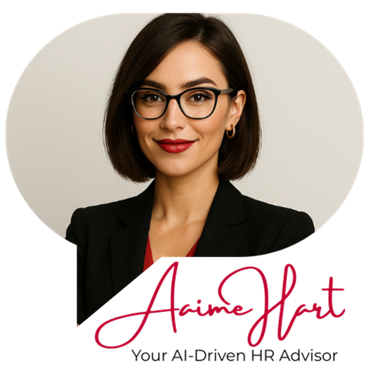


Hearing Direct From the Source
Notes:
Click on images to launch the resources.
Prompt each of the AI with the following (OR you can choose to split it up between the AI, your call): How can HR utilize AI in performance management? ----→>>>Follow Up Prompt: How can my managers use AI for performance management?

Slide 5
01.
Feedback & Coaching
Where AI Shows Up Today
02.
Goal Setting Support
Have you seen or tried AI in any of these areas yet?
03.
Spotting Trends
04.
Bias Reduction
Notes:
In surveys, ~58% of organizations use AI for performance management. (Hirebee)
Gartner’s survey: 74% of HR leaders say AI has improved fairness and accuracy in performance evaluation. (Psico Smart Blogs)
AI helps with: auto-feedback drafting, identifying coaching opportunities, flagging outliers, schedule nudges. (Betterworks)
A systematic lit review found that AI in performance management enables continuous feedback, data-driven insights, and reduces bias in evaluations. (ResearchGate)
According to AIHR, AI can lighten the administrative burden in performance systems, freeing HR to focus on strategy. (AIHR)
Ask the following: “Which of these use cases feels most plausible in your org? Why?”
Review the prompt card and give example of how number 2 can flow into number 3 and how assessments can be incorporated.
If needed you can use the following question to boost conversation:
“What data sources would you need to support AI in your context (metrics, qualitative feedback, survey data)?”

Slide 6
Hearing Direct From the Source
Notes:
Click on images to launch the resources. - Important to note during the conversation, below is a very generic prompt, the more data you give, the more detail provided, the better the results.
Prompt each of the AI with the following (OR you can choose to split it up between the AI, your call):
I have a time sensitive project that my team is working on and currently we are not overly cohesive on our communications, strategy and collaboration. Two of my team are leaders. Please take the Adapter and Specialist PI Profile assessments of these individuals and help me to outline clear steps forward for how to better guide and communicate with these two leaders so we can meet our project deadline successfully.
Follow up prompt: Can you give me a 3 week time line?
Final prompt: Now add into the mix, that there are 3 other team members: a Individualist, a Collaborator and a Promoter. How will this factor into the ability of this timeline to be effective, where might we run into issues, what are some areas that you would recommend we put extra focus on?

Slide 7

The Promises vs. The Pitfalls
Promises: Efficiency, consistency, early insights
Pitfalls: Bias, data privacy, over-reliance, transparency
Notes:
Promises / Strengths • Efficiency & time saved (automation of admin). • Consistency in language, detection of trends across many data points. • Potential to reduce some bias by standardizing phraseology.
Pitfalls / Risks • Bias baked in: AI learns from historical data, which might embed past unfairness. • Privacy & data security, sensitive info being exposed or improperly used. • Trust gap: managers might resist or overrule AI. • Overreliance: “AI said so” becomes a shield, not a support.
If needed you can use the following question to boost conversation:
Which promise is most compelling to your org? Which risk feels most urgent to you?

Slide 8

What would you want AI to “fix” in your process?
Notes:
Optional slide, mostly been skipping.
If AI drafted 80% of your performance reviews, would you use it? Why or why not?
How would you explain AI’s role in feedback to employees without freaking them out?

Slide 9

Let’s Discuss!
Scenario 1 - Early Flight Risk Warning
AI flags an employee as a high turnover risk based on trends (engagement survey comments, missed deadlines, reduced participation in meetings). The manager had not noticed anything unusual.
Notes:
Introduce the exercise as a “Let’s pressure test our instincts” activity.
Set the ground rule: This is not about right or wrong—it’s about how we think about AI’s role.
Position it as “real-world messy,” not hypothetical theory.
Remind participants: these are ambiguous, high-stakes moments where judgment, data, risk all collide.
Do you trust the AI flag, or do you wait until you personally see signs? – This has been tripping people up!
If you act, how do you approach the employee without causing panic? – This is has been a good discussion question.
What risks come from ignoring the AI signal?

Slide 10

Let’s Discuss!
Scenario 2 - Positive Outlier Performance
AI highlights an employee as consistently outperforming peers, suggesting they could be ready for promotion sooner. The manager disagrees based on personal observations.
Notes:
Debate prompts:
Do you lean on the AI’s data, or your gut?
Could bias be clouding your judgment—either yours or the AI’s?
What’s the cost of over- or under-estimating someone’s readiness?

Slide 11

Let’s Discuss!
Scenario 3 - Feedback Tone Analysis
AI reviews draft performance reviews and flags manager comments as potentially “too negative” in tone. The manager insists the comments are fair and accurate.
Notes:
Debate prompts:
Should tone analysis shape feedback delivery?
When does “softening” feedback help—and when does it water it down?
If AI changes the tone, is it still authentic feedback?

Slide 12

Try it out!
What’s one small, practical step you might try with AI in performance?
Notes:
Remind them: most organizations are only scratching the surface; AI is a partner tool, not a “set-and-forget” system.
Reiterate the importance of pilots, human oversight, communication, feedback loops.
Insight from research: The AI maturity gap is less about tech and more about leadership and process. (McKinsey & Company)
Encourage them to pick one micro experiment, one question to test next.
“What’s one small pilot you can run in the next 90 days to test AI in your performance process?” “Who in your org must be bought in (C-Suite, managers, employees) for that pilot to work—and how will you get them on board?”

Slide 13


THANK YOU
A heartfelt thank you to each participant for your active participation and valuable contributions.
314-754-0236
Solutions.team@aaimea.org
www.aaimea.org

