Slide 1


Compensation & Benefits Confessions: What We Learned from Hundreds of Failed Programs
Michael Maciekowich
Astron Solutions, LLC

Slide 2
Forget the Unemployment Rate: Reality of Population Trends in the United States

Slide 3

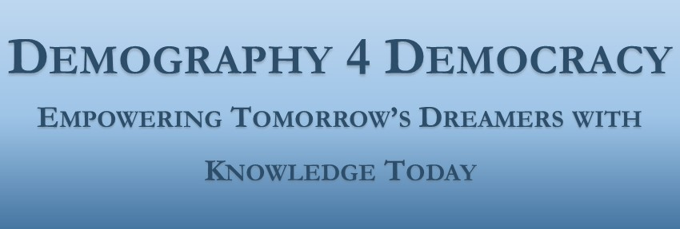
Migration Trends
Ness Sándoval Professor of Demography and Sociology
Saint Louis University
Migration Trends

Slide 4
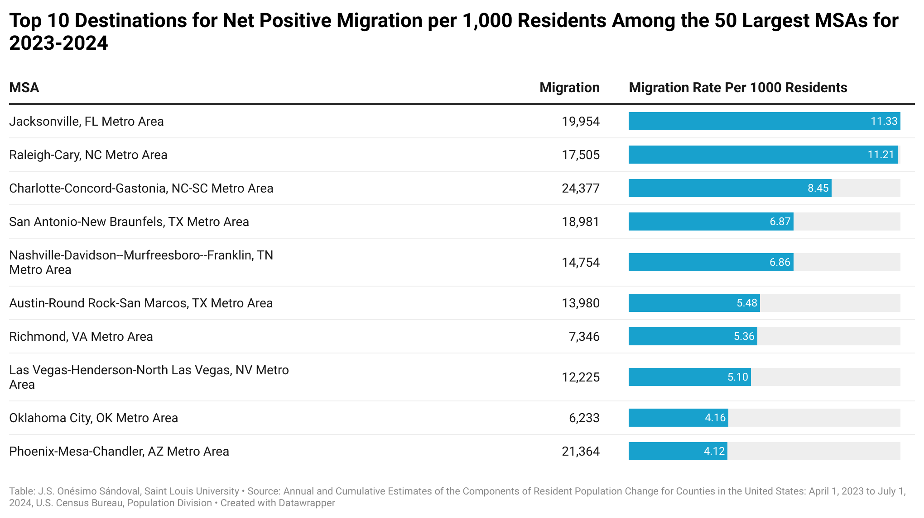

Slide 5
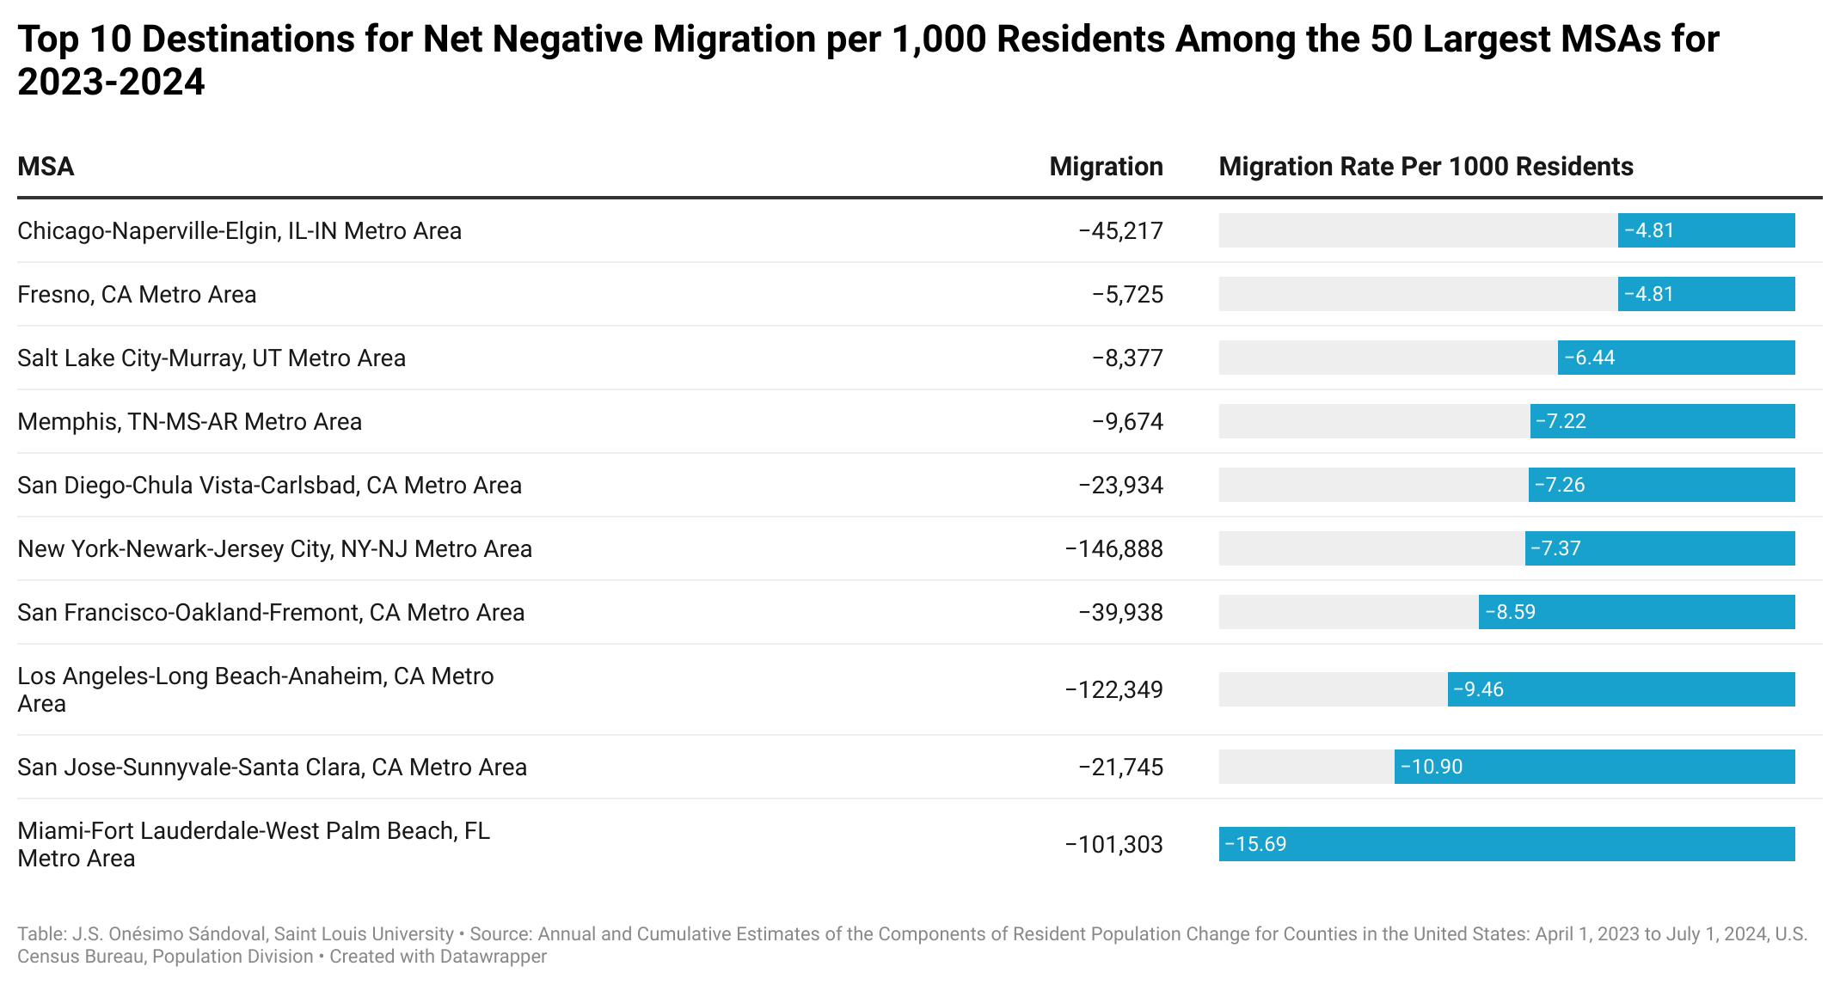

Slide 6
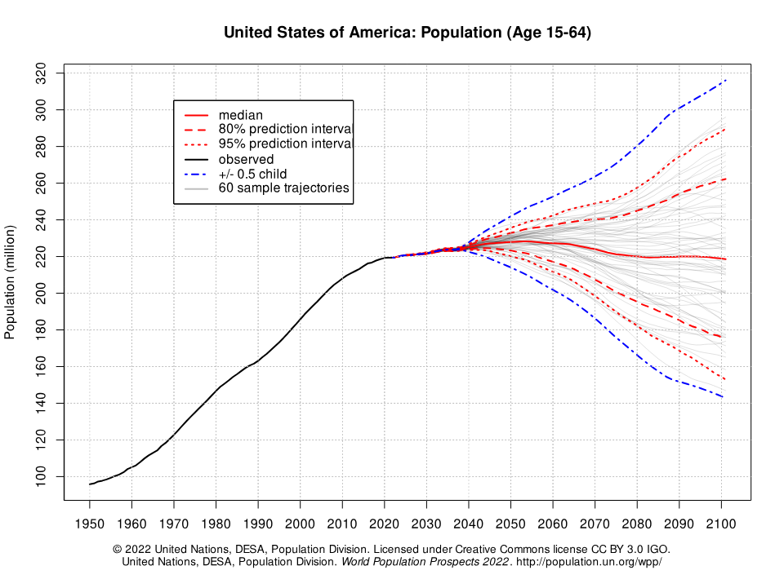
U.S. POPULATION (Age 15-64)
2025
2040
Transitioning from 60 consecutive years of annual population growth of approximately 2,000,000 people to an increase of
250,000 people per year for the next 20 years (120 million vs. 5 million)
Notes:
Today we face an even bigger challenge. A challenge that leaders before us have not faced. These combined challenges will likely produce an inflection point in business - and in mankind.
Artificial Intelligence is re-writing our lives – as we sit here in this room
Hybrid & remote workforce creates trust, engagement, and productivity issues
Major demographic & migration shifts
A declining population / Fewer births – fewer people entering the workforce
We are transitioning from 60 consecutive years of annual population growth of approximately 2M people to a current annual population growth of only 250K

Slide 7

Hour 1 Compensation Confessions: The Wage Wars Reality

Slide 8

Segment 1 The Ugly Truth About Wage Strategy (30 Minutes)

Slide 9
Inflation Response Disasters We’ve Seen Firsthand
In response to the nation’s rising inflation, client organization’s have encountered at least one of these five questions:
Should we give non-merit pay raises – like a cost-of-living (COLA) increase – across the board?
How will we handle employee raise requests?
Do we risk losing people if we don’t give raises?
How does the decision to raise pay (or not) impact our ability to recruit strong talent (especially in the Great Resignation era)?
Will we run into pay compression issues?

Slide 10
AI Wage Disruption: The Companies that Got Blindsides (Research from Salary.com)
AI has immense potential to optimize compensation management, but companies must be aware of its challenges. These include:
Data Quality and Bias
AI systems are only as good as the data used to train them. Flawed, limited, or biased data can lead to unfair or inaccurate outcomes. For compensation, AI must use high-quality data that fully represents employee roles, performance, and other relevant attributes. Companies must audit data to ensure AI is not perpetuating unfair pay practices.
Explainability
AI models can be complex "black boxes,” making it difficult to understand exactly how they arrive at specific pay suggestions or decisions. Stakeholders will want insights into how AI is evaluating employee contributions and performance to set pay. Companies must require explainable AI systems to provide this transparency.
Inflexibility
AI models may lack the flexibility to handle the nuances of compensation management. They may struggle with one-off cases or exceptions or fail to account for soft skills and other complex factors in pay decisions. Human judgment and oversight will still be vital to ensuring fairness and correctness.
Employee Perceptions
If not managed properly, the use of AI in compensation can negatively impact employee views and trust in the pay process. Employees may feel that AI cannot properly gauge their unique value or skills. Extensive communication about
how AI will—and will not—be used and prospects for employee input can help address these concerns.

Slide 11
Pay Transparency Train Wrecks and Legal Nightmares
According to PayScale, if the process is not transparent, employees — particularly younger ones — may be more likely to leave a company within six months. However:
Transparency drives managers to make employees’ performance-based incentives more similar to each other — in other words, compressing them — thereby reducing the pay dispersion driving employee concerns and complaints about pay inequity.
Employees respond to transparency-induced pay compression by seeking alternative ways to receive the reward they feel is due to them. If a reduced pay range reduces the likelihood of securing these rewards in the form of a pay increase, employees may solicit other forms of less-visible remuneration from their bosses.
Not only was transparency-induced pay compression likely to drive employee requests for i-deals, but these requests were also more likely to be granted by supervisors.
Pay transparency, in effect, becomes a moving target, shifting reward systems from what is observable (pay) to what is unobservable (i-deals). This is particularly concerning because recent evidence suggests that this shift toward differential remuneration in the form of less-visible benefits may come at the cost of gender pay equity.

Slide 12
Regional Wage Arbitrage Catastrophes
Client organization’s face several challenges when implementing geographic pay differentials, such as maintaining internal pay equity while managing location-based pay for employees working remotely.
Employees may desire the flexibility of remote work but might not understand the long-term implications of geographic pay differentials.
When developing a geographic pay policy, companies must consider factors like the number of locations, employee roles, and HR system limitations.
To address these challenges, employers can choose various methodologies for geographic pay differentials, including national, regional, state, and city-based approaches.
Applying geographic pay differentials can differ based on whether the compensation structure is flat, based on individual adjustments, or tied to new hires.
Employers must consider state and local tax regulations as they can vary significantly and affect implementation.

Slide 13
Performance Pay Systems the Destroyed Culture
Pay for Performance may have a negative effect on teamwork if employees feel they are competing with each other.
Pay for performance can distract from team objectives if employees are more focused on their own skills or productivity.
Pay for performance can result in too much focus on quantity of work, rather than quality. This, in turn, can lead to employee stress.
Pay for Performance can risk putting too much focus on objective skills that can be measured by quantifiable metrics. This can result in less focus on subjective but equally valuable skills, such as communication and creativity.
An established performance-based compensation plan can be difficult to change or update. It can also be difficult to end if the program is not giving you the results you expected. This can lead to increased turnover if employees feel cheated out of previously offered bonuses.
Finally, if you don’t ensure your managers apply your pay for performance strategy consistently,
it can lead to favoritism. It can also highlight potential deficiencies. For example, certain
employees might not meet expectations because they do not have sufficient training.

Slide 14
Discussion

Slide 15

Segment 2 Learning from the Wreckage (30 Minutes)

Slide 16
2026 Predictions Base on Actual Failure Patterns
Base-Pay Pay for Performance will be replaced by a combination of base pay adjustments (for doing the job) and a variable portion (to recognize above expected results)
Pay for Job Competency will replace Pay for Performance and become the focus of movement through the pay range.
Employee Career progression programs will become the cornerstone of future compensation programs in response to Gen Z and Gen Alpha expectations.
There will be increased emphasis in management compensation training to support pay transparency and pay equity issues within the organization.
As data sources improve, Human Resources will begin to incorporate more AI based data in compensation market analysis.

Slide 17
Legislative Changes: Companies the Ignored the Warnings
Pay transparency has become a focal point in labor law reforms. Although federal pay transparency legislation has yet to gain momentum, state initiatives have made significant strides. Looking ahead, the trend is set to continue, as numerous states have pay transparency bills in the legislative pipeline for 2026.
In 2025, numerous states have enacted legislation to raise their minimum wages. Over 20 states have implemented higher minimum wages starting in January 2025 while other states such as Florida and Nevada have mid-year increases. More to come in 2026.
Diversity, equity, and inclusion initiatives have come under increased discussion in 2025. A recent Executive Order mandates federal agencies to end DEI programs and encourages private entities to follow suit. However, many organizations are continuing with the DEI initiatives as planned as such initiatives promote non-discrimination and inclusion in full compliance with the laws.
The integration of artificial intelligence in HR processes has gained momentum. However, the use of AI in employment decisions has raised concerns about fairness and potential biases. In response, states, including Colorado and Illinois, have passed legislation, set to take effect in 2026.

Slide 18
Skill-Based Pay Implementations that Imploded
Advantages
Skill-based pay can enhance employee retention rates as it motivates employees to remain in their roles and continue upskilling.
Providing skill-based employee incentives can lead to improved performance and also foster a culture of innovation and development.
Skill-based compensation encourages employees to take ownership of their work and focus on advancing their own skills, thereby contributing to the growth of the company.
This model encourages employees to pursue additional training and develop new skills, enabling them to earn on par with their more skilled colleagues.
Drawbacks
Skill gaps among employees can lead to pay inequities, as some individuals may earn significantly more than their peers due to variations in their skill levels.
Additionally, administrators and HR professionals need to meticulously track individual assessments, training outcomes, and salaries to effectively implement the skill-based pay model, which can be complex.
Implementing this model requires experienced recruiters and trainers, potentially leading to substantial human resources and training programs investments.
Skill-based compensation can also result in higher compensation costs compared to competitors, especially for high-specialization positions.

Slide 19
Executive Compensation Scandals We Can’t Name
Scandal #1: Lack of Compensation Strategy
When you lack a strategic approach or financial controls in managing your organization’s compensation, you miss out on a powerful lever for attracting, retaining, and motivating executives.
Scandal #2: Using Anecdotal Compensation Data
Relying on anecdotal compensation data—the most common example being “Googling” data for an executive position—can be a misstep for any organization. When you piece together compensation benchmarks from a variety of scattered sources, you’re missing out on reliable, validated data that’s necessary for accurate and informed decision-making.
Scandal #3: Overpaying and Underpaying Executives
We mentioned above that simply “Googling” compensation data can ironically lead to both overpaying and underpaying executive, causing financial strain and inequity within your organization.
Scandal #4: Being Reactive Rather Than Proactive
Waiting until your top performing executives are on the verge of leaving before addressing pay concerns is an issue. But it often also leads to hasty and costly fixes that don’t end up addressing the
underlying issues.

Slide 20
Remote Work Pay Strategies that Triggered Mass Exodus (Three companies that ended remote work for the wrong reasons)
StatusPage: Remote work isn’t for everyone
A couple of years ago, co-founder Steven Klein wrote on Reddit2: “… some people just aren’t wired for working remotely… For people who are used to and need to be around people to be happy, this can be an enormous problem. To be honest, I haven’t been myself and I haven’t truly been happy since leaving [his previous job], and I feel like it’s due to the isolation of working remotely.”
Yahoo!: Less innovation
The internal memo by the then head of Human Resources, Jackie Reses, was leaked and made public, revealing (to put it mildly) a ham-fisted, disastrous decision, and an even worse memo. “Speed and quality are often sacrificed when we work from home,” the memo read. “And, for the rest of us who occasionally have to stay home for the cable guy, please use your best judgment in the spirit of collaboration.” The memo was revealing of a severe erosion of trust in employees, which in itself is a killer of employee engagement, remote or not. Employees also anonymously reported that there was “little effort to stay in touch regularly.”
Best Buy: “Too much freedom”
One interesting thing about Best Buy is that it didn’t call remote work “remote work.” It called it a “Results-Oriented Work Environment (ROWE).” The focus is on the productivity and accomplishments of the employee and not their location or the number of hours they took.

Slide 21
2026 Fearless Forecast

Slide 22
The Latest Numbers from ADP Jobs Report
ADP National Employment Report: Private Sector Employment Increased by 54,000 Jobs in August; Annual Pay was Up 4.4%
Median Change in Annual Pay
Job-stayers 4.4%
Job-changers 7.1%
Median Change in Annual Pay for Job-Stayers by Industry
Natural resources/mining 4.3%
Construction 4.4%
Manufacturing 4.7%
Trade/transportation/utilities 4.2%
Information 4.2%
Financial activities 5.1%
Professional/business services 4.2%
Education/health services 4.4%
Leisure/hospitality 4.5%
Other services 4.1%

Slide 23
Summary of 2026 Compensation Budgeting (Base Pay Only)
Payscale: 3.5% Average Annual Increase
WorldatWork: 3.6% Average Annual Increase
Willis Towers Watson: 3.5% Average Annual Increase
Gallagher: 3.8% Average Annual Increase
Economic Research Institute: 3.6% Average Annual increase
Salary. Com/Comp Analyst: 3.5% Average Annual increase
Per WorldatWork, highest Budgeted Increases by industry:
Business Services: 4.0%
Engineering: 4.2%

Slide 24
Discussion

Slide 25

Six Compensation Checklist for Your Use to Audit Current Programs See Excel File Provide

Slide 26

Check List Provided
Compensation Program Audit Checklist
Pay Equity Audit Checklist
Salary Benchmarking Checklist
Pay Transparency Checklist
Performance Review Audit Checklist
Learning & Development Audit Checklist
Career Progression Program Checklist

Slide 27



Thank You!
Michael Maciekowich
212.792.8886
michaelm@astronsolutions.info
/michaelmaciekowichastron/

