Slide 1
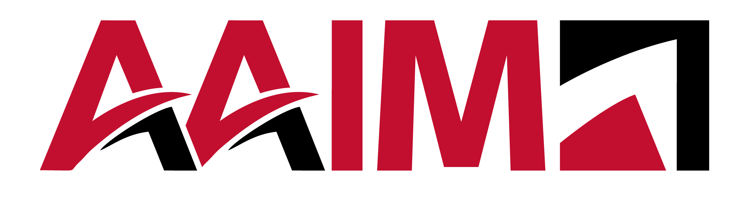
Maximizing Employee Engagement
What matters most, now!
Notes:
Speaker Notes:
Welcome everyone and thank you for joining today’s roundtable.
I’m [Your Name], and I’m excited to lead this discussion on employee engagement strategies for 2025.
Before we dive in, a quick reminder: this is an interactive session—your insights and experiences are just as valuable as the content I’ll share.
Let’s start with a quick introduction—name, role, and one workplace challenge you’d love to solve.

Slide 2

Agenda
Population Decline
College Graduation Rates are Plummeting
Peak 65
Let’s talk Strategy and get Results!
Notes:
Engagement is the key driver of retention, productivity, and business success.
Organizations with high engagement report 23% higher profitability (Gallup, 2023).
The workforce is shifting—Gen Z and Millennials demand purpose, flexibility, and recognition.
AI and automation are changing job roles, making human-centered engagement even more critical.
The rise of remote and hybrid work has challenged traditional engagement strategies—leaders must rethink how to keep employees connected and motivated.
Today’s employees have more choices than ever; disengaged employees will leave for better opportunities.
Engagement isn’t just about surveys and perks—it’s about daily experiences, leadership, and culture.

Slide 3

Population Decline
Aging Workforce & Retirements
Declining Birth Rates
Skill Gaps & Talent Shortages
Reduced Labor Market Flexibility
Increased Employer Competition & Retention Challenges
Notes:
There are several external impacts that will have a substantial impact on employee engagement that you may have not even considered …. 1.

Slide 4
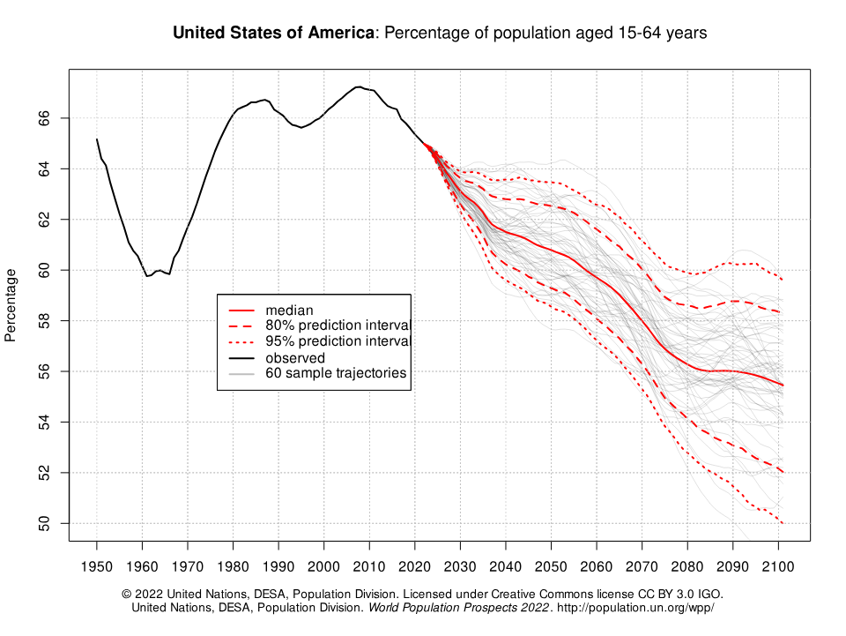
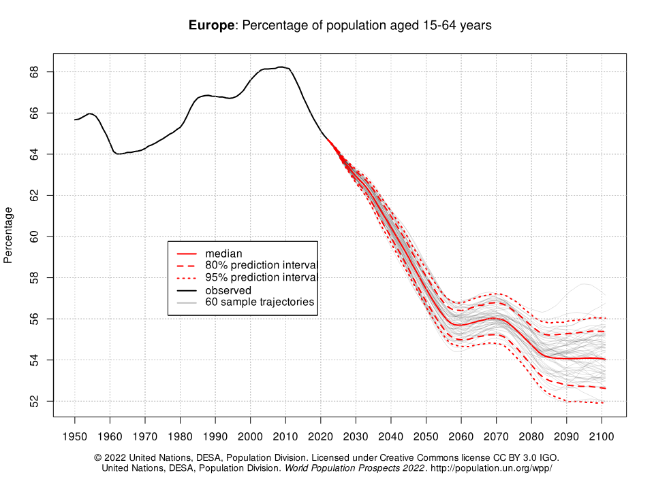
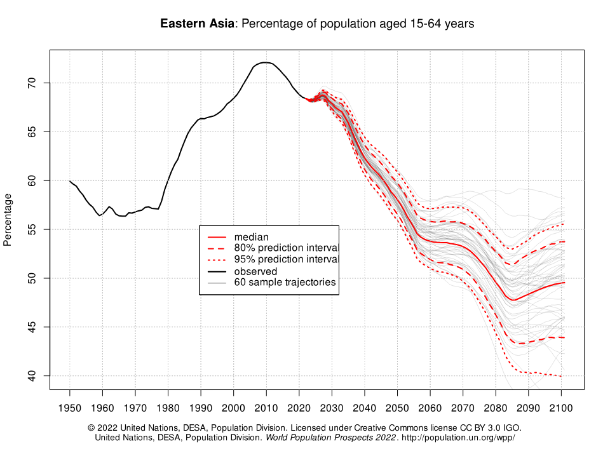
A
% of Total Population
(Age 15-64)
a
Notes:
Introduction:
Population decline is leading to a smaller workforce, meaning fewer available workers for open roles.
This will intensify competition for talent, making hiring more challenging across industries.
Why the Job Market Will Tighten:
Aging Workforce & Retirements
Many baby boomers are retiring, and fewer young workers are available to replace them.
Industries with high retirement rates (manufacturing, healthcare, public sector) will feel this the most.
Declining Birth Rates
Fewer young people entering the labor force means a long-term talent shortage.
Countries with birth rates below replacement levels (e.g., Japan, Germany, China) are already seeing workforce contraction.
Skill Gaps & Talent Shortages
Fewer workers means higher demand for skilled professionals, leading to wage increases and more incentives to attract talent.
STEM, healthcare, skilled trades, and AI-driven roles will be especially in demand.
Reduced Labor Market Flexibility
Companies won’t have the same talent surplus to draw from, leading to longer hiring cycles and higher recruitment costs.
Businesses may struggle to fill critical roles quickly, affecting productivity and innovation.
Increased Employer Competition & Retention Challenges
Companies will compete aggressively to attract and retain workers.
More counteroffers, higher wages, and expanded benefits (e.g., remote work, professional development).
Employee expectations will rise, putting pressure on employers to improve culture and career paths.

Slide 5
College Graduation Rates are Plummeting
The “Enrollment Cliff” (2025 and Beyond)
Declining College Enrollment Trends
Notes:
Introduction:
The U.S. and many other countries are about to experience a sharp decline in college graduation rates over the next decade.
This is due to demographic shifts, declining birth rates, and fewer students enrolling in higher education.
The result? A tighter job market, skill shortages, and a major shift in workforce dynamics.
Why College Graduation Rates Are Declining:
The “Enrollment Cliff” (2025 and Beyond)
The number of high school graduates is shrinking, particularly in the U.S., due to lower birth rates since 2008.
Colleges are already seeing fewer incoming students, meaning fewer graduates entering the workforce in the next 4-6 years.
Declining College Enrollment Trends
More young adults are skipping college in favor of trade schools, boot camps, apprenticeships, and direct-to-work pathways.
Rising tuition costs and student debt concerns are pushing people toward alternative education and skills training.

Slide 6
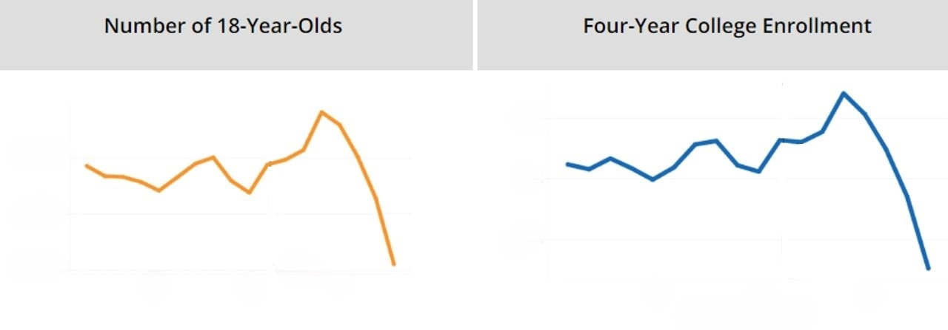
Declining Higher Education Enrollment
3800K
3600K
3400K
9,000,000
8,500,000
8,000,000
9,000,000
8,500,000
8,000,000
2024
2024
2016 2021 2026
2016 2021 2026
Year of HS Graduation
Between 2025 and 2029, the number of college-bound students will decline by over 400,000 fewer students in a span of four years, an average loss of 100,000 students per year.
a
Source: https://www.synario.com/resources/blog/enrollment-cliff/

Slide 7
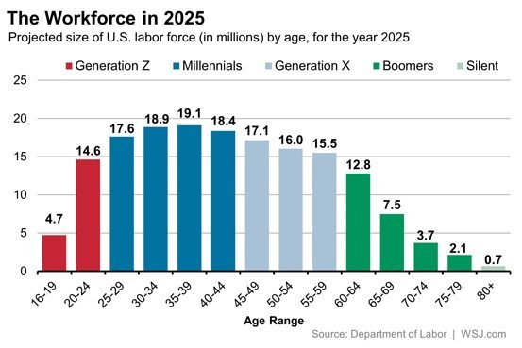
Peak 65
Notes:
12.8 +7.5 = 20.3 20% of the population is at retirement age with another 15.5% only 5 years behind – succession planning is the word of the year!
People are both working longer and retiring earlier and so it isn’t as predictable. And for most companies your most stable workers have 20+ years of experience, and they have been steadily working away as you have been focused on high turnover positions. This is catching organizations off guard by the sheer number of people that are reaching a retirement window in the next 10 years.

Slide 8

01
Labor Market Remains Tight
03
Bridging the Generation Gap is Key
02
Developing Current Employees is Essential
04
Alignment to Strategy is Paramount
Notes:
Labor market remains tight – efficient recruiting is key, know exactly what you have to hire for and what you can develop, ensure that the job needs are aligned to market rates
Get clear on what skills are needed and how you can develop them internally if needed
When you hire GenZ how do you integrate them and not have them feeling like outsiders, how do you develop soft skills so that they succeed
Alignment to Strategy = efficiency – can’t apply technology until you standardize, have to be efficient so that all oars are pointed the same direction gaining speed. No time for waste
And with all of that you might be thinking Where do I start? And the first thing is to get to the root cause of the issues and you can only do that with data.

Slide 9
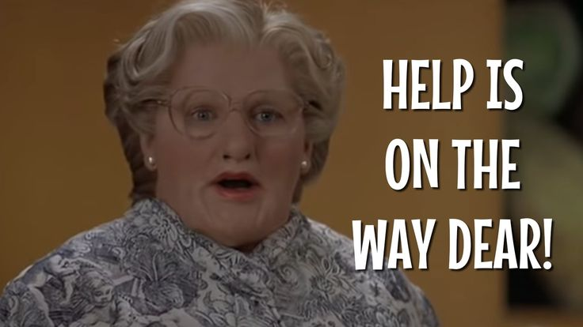
Notes:
For all of my Gen Xers …
As heavy as all of this may seem, we know as HR professionals that there are strategies we can deploy to adapt, evolve, and ensure that our people remain our strongest asset.
Yes, we’re facing an expertise gap, a rapidly changing AI landscape, and a workforce struggling with connection, but this isn’t the first time HR has had to pivot in a major way. The difference now is that we have the tools, insights, and influence to lead our organizations through this transformation.
So, what can we do?

Slide 10
Let’s Talk Strategy!
Notes:
Engagement and measuring the people aspects of the organizations helps you to drill down and the real issues, it helps you to identify your populations and it opens up a broader conversation among all leaders of the organization. It matters because it identifies root causes of problems and allow you to act, responsibly to stabilizing and engaging your current workforce so that you can focus on all of the other challenges headed are way.
An engaged workforce is easier to recruit into
An engaged workforce creates retention
An engaged workforce is and efficient workforce because there is trust and alignment

Slide 11
Why Does Engagement Matter?
Employee engagement matters for business strategy because it directly impacts the organization's ability to achieve its goals and maintain a competitive edge. Here's why:
Improves Performance & Productivity
Drives Innovation
Enhances Customer Satisfaction
Strengthens Retentions & Reduces Costs
Aligns Employees with Organizational Goals
Builds A Resilient Culture
Boosts Financial Performance
When engagement is integrated into the business strategy, it not only boosts operational efficiency but also ensures that the organization remains agile, innovative, and aligned with its mission.
Notes:
1. Improves Performance and Productivity
Engaged employees are more motivated, focused, and committed to their work. They tend to go above and beyond, leading to increased productivity and higher-quality outcomes.
2. Drives Innovation
Engaged employees feel a strong connection to their work and the company’s mission. This connection fosters creativity and encourages them to contribute innovative ideas that align with strategic goals.
3. Enhances Customer Satisfaction
When employees are engaged, they deliver better customer service and experiences, which strengthens brand loyalty and reputation—key components of any successful business strategy.
4. Strengthens Retention and Reduces Costs
Engaged employees are less likely to leave, reducing turnover-related costs like hiring, onboarding, and training. Retaining top talent also ensures continuity in executing the business strategy.
5. Aligns Employees with Organizational Goals
Engaged employees understand and believe in the company’s strategic direction. They’re more likely to align their daily efforts with the organization’s long-term objectives, ensuring a cohesive and coordinated approach.
6. Builds a Resilient Culture
A culture of engagement fosters trust, collaboration, and adaptability—qualities that are essential for navigating challenges and sustaining long-term success.
7. Boosts Financial Performance
Research consistently shows that companies with highly engaged workforces outperform their competitors in profitability, revenue growth, and shareholder value.
When engagement is integrated into the business strategy, it not only boosts operational efficiency but also ensures that the organization remains agile, innovative, and aligned with its mission.

Slide 12
What Are You Seeing?
What are the top three themes emerging from your recent engagement survey, and how do they align with your business strategy goals?
Is there alignment between people and strategy when your strategy shifts?

Slide 13
From Data to Action
How do you determine which engagement themes or challenges to prioritize for immediate action?
What criteria do you use to align engagement survey results with your broader strategic plan?

Slide 14
Leadership’s Role
What steps can leadership take to ensure alignment between engagement survey findings and their day-to-day decisions?
How do you involve managers and team leaders in the process of turning survey results into actionable plans?

Slide 15
Sustaining Progress
How do you measure the success of initiatives implemented in response to survey feedback?
What strategies have you found effective for maintaining engagement focus beyond the survey results?

Slide 16
Navigating Barriers
What barriers have you faced when implementing changes based on engagement data, and how have you addressed them?
How do you ensure transparency and maintain trust when changes take longer than expected?

Slide 17
Let’s Talk About Results
Notes:
Tranisiton slide

Slide 18
EOES in Action - Situation
When we began working with this organization, employees described a culture of fear, distrust, and misalignment. Leadership transitions had created instability, and employees felt like they were walking on eggshells, unsure of expectations or the organization’s future.
Key Challenges
Lack of trust in leadership
Fear-based management
Silos & poor collaboration
Unclear strategic direction
Compensation concerns
Turnover Risk
Notes:
When we began working with this organization, employees described a culture of fear, distrust, and misalignment. Leadership transitions had created instability, and employees felt like they were walking on eggshells, unsure of expectations or the organization’s future.
Key challenges included:
Lack of trust in leadership: Employees felt that leaders were unresponsive, inconsistent, and failed to follow through.
Fear-based management: Many employees hesitated to speak up, fearing retaliation or being ignored.
Silos & poor collaboration: Departments operated independently, limiting transparency and cross-functional teamwork.
Unclear strategic direction: The organization went through leadership changes, implemented a return-to-work policy, and introduced a new member offering, creating additional stress.
Compensation concerns: Employees perceived pay structures as unclear and uncompetitive.
Turnover Risk: Many key positions at risk.
These issues led to low engagement scores, high frustration, and uncertainty—all of which put
long-term retention and organizational success at risk. Once we gained a clear understanding of the underlying issues, we focused on targeted strategies that would drive real change.

Slide 19
EOES in Action - Action Steps
Our Approach
Employee Opinion & Engagement Survey (EOES): Measured key issues and provided a clear starting point for action.
Employee Focus Groups: Gave employees a voice and helped diagnose root causes of disengagement.
Leadership Development & Coaching: Equipped leaders with the tools and skills to lead with integrity, consistency, and accountability.
Culture-Building Initiatives:
Monthly executive leadership meetings focused on trust, communication, and decision-making transparency.
Monthly all-employee meetings reinforced core values and encouraged open dialogue.
Compensation Benchmarking Study: Ensured that pay structures were fair, transparent, and market-competitive.
Notes:
Recognizing the need for lasting change, the leadership team made a critical decision—to consistently take action over time and rebuild trust through transparency, accountability, and engagement.
We partnered with them to implement a multi-layered strategy focused on data-driven insights and ongoing leadership development.
Our Approach
Employee Opinion & Engagement Survey (EOES): Measured key issues and provided a clear starting point for action.
Employee Focus Groups: Gave employees a voice and helped diagnose root causes of disengagement.
Leadership Development & Coaching: Equipped leaders with the tools and skills to lead with integrity, consistency, and accountability.
Culture-Building Initiatives:
Monthly executive leadership meetings focused on trust, communication, and decision-making transparency.
Monthly all-employee meetings reinforced core values and encouraged open dialogue.
Compensation Benchmarking Study: Ensured that pay structures were fair, transparent, and market-competitive.
Importantly, these weren’t one-time initiatives. Leadership committed to ongoing action, engagement, and transparency, which allowed employees to see, believe in, and trust the change

Slide 20
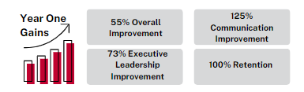
EOES in Action - The Results
Notes:
Recognizing the need for lasting change, the leadership team made a critical decision—to consistently take action over time and rebuild trust through transparency, accountability, and engagement.
We partnered with them to implement a multi-layered strategy focused on data-driven insights and ongoing leadership development.
Our Approach
Employee Opinion & Engagement Survey (EOES): Measured key issues and provided a clear starting point for action.
Employee Focus Groups: Gave employees a voice and helped diagnose root causes of disengagement.
Leadership Development & Coaching: Equipped leaders with the tools and skills to lead with integrity, consistency, and accountability.
Culture-Building Initiatives:
Monthly executive leadership meetings focused on trust, communication, and decision-making transparency.
Monthly all-employee meetings reinforced core values and encouraged open dialogue.
Compensation Benchmarking Study: Ensured that pay structures were fair, transparent, and market-competitive.
Importantly, these weren’t one-time initiatives. Leadership committed to ongoing action, engagement, and transparency, which allowed employees to see, believe in, and trust the change

Slide 21
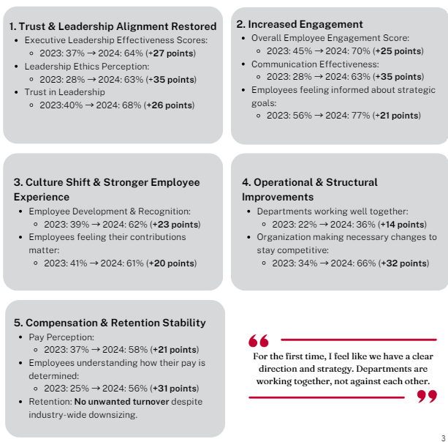
EOES in Action - The Results
Notes:
The numerical gains are significant but perhaps even more so were the employee comments
"Leadership is now transparent. I feel heard and included in decisions that impact my job."
"Our leadership team is committed to self-evaluation, vulnerability, and real change. They are listening to employees and acting on feedback."
"For the first time, I feel like we have a clear direction and strategy. Departments are working together, not against each other."
"Leadership finally prioritized fair pay. The salary adjustments showed they value us."

Slide 22

Why This Worked!
Key Success Factors
Leadership Alignment
Data-Driven Strategy
Employee Involvement
Fair Pay Practices
Notes:
Many organizations attempt quick fixes for engagement issues, but sustainable change only happens when leadership commits to consistent action over time.
The real turning point wasn’t just the surveys or training—it was the leadership team’s decision to show up every month, engage with employees, follow through on commitments, and build trust through action.
Key Success Factors:
Leadership Alignment: Regular coaching and commitment to transparency helped leaders communicate and lead more effectively.
Data-Driven Strategy: The EOES survey and focus groups pinpointed the real issues and guided targeted actions.
Employee Involvement: Consistent monthly meetings gave employees a voice and a clear sense of direction. Fair Pay Practices: A compensation study ensured competitive pay, reinforcing trust and retention.
Investment: ~$65,000 Impact: A highly engaged workforce, restored trust, and stabilized retention—all critical for long-term success.
And a year later, their scores continue to trend higher, we are still working with them to provide stabilization.

Slide 23

One hour of strategic consulting with Tanya Zion!
Drawing to be held on February 26th and winner notified via email from Erin Miley

