Slide 1
Enhancing Engagement and Retention
a

Slide 2
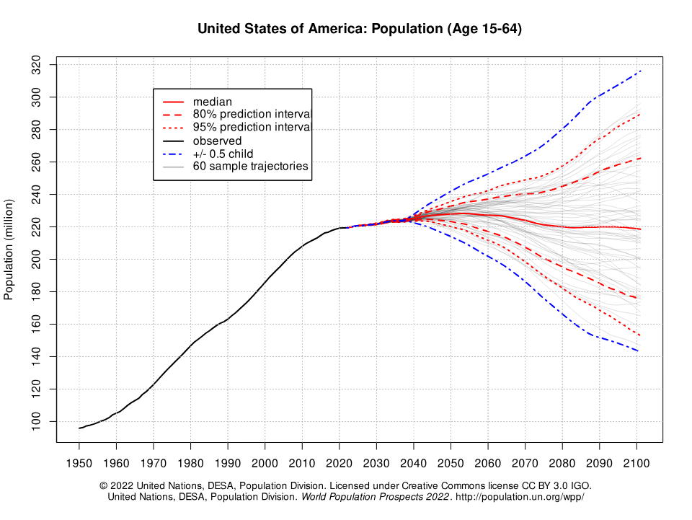
2024
2040
United States
Population
(Age 15-64)
Transitioning from 60 consecutive years of annual population growth of approximately 2,000,000 people to an increase of 250,000 people per year for the next 20 years (120 million vs. 5 million)
a
Notes:
5 MILLION OVER THEXT 20 YEARS THAT IS 250k / YEAR
If everything is equal and you divide that number by 50 states each state would get 5000 additional people / year
Now divide that by the number of counties in each state the increase each county should expect to see based on this projection
For Missouri 44
Illinois 49
Indiana 54
Florida 74
That’s not enough people. Keep in mind they will be 15 years old?

Slide 3
Herzberg Satisfiers
Does your workplace offer a
healthy/pleasant environment?
Is your pay competitive?
Do you have a
safe/secure workplace?
Is the location of your business
accessible/preferable?
Is there continuity/job security
at your business?
Are your employees satisfied
with their professions/industry?
a

Slide 4
Herzberg Motivators
Do your employees feel like they have a purpose because of their job? Do they know their purpose?
Does your company employ quality leaders that create an environment of engagement?
Do your employees have friends/colleagues at work?
Is the employee’s work
interesting/challenging?
Do employees at your business
treat each other with respect & fairness?
Does your company have any recognition/appreciation initiatives?
Do your employees feel like they have autonomy/are involved?
Do your employees feel like they receive communication and are in the know?
a

Slide 5
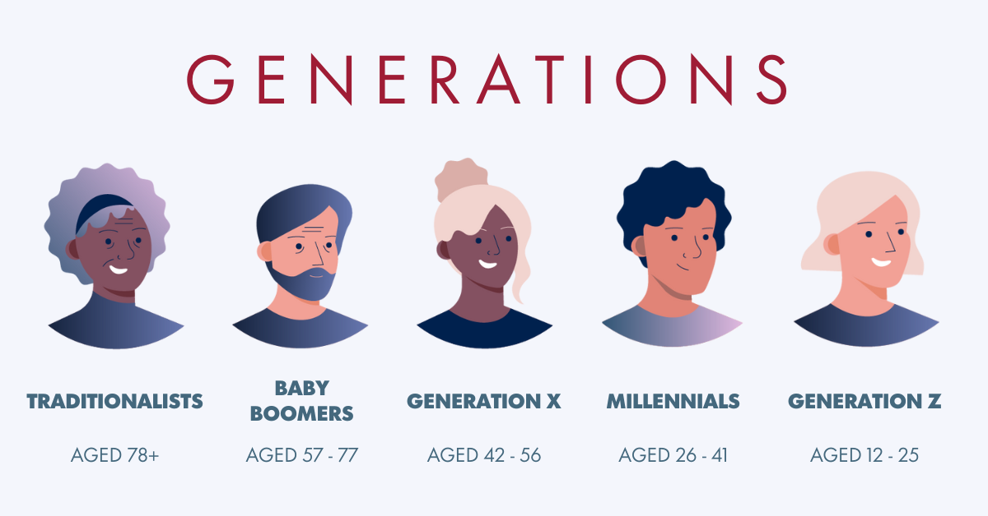
Generations in the Workplace
a

Slide 6
What challenges do you face engaging all generations in your organization?

Slide 7
Generations Best Practices
Communicate Preferences Openly: Encourage your teams to communicate their preferences openly. There is no right or wrong work style or method of communication.
Respect Boundaries: A wider representation of age groups at work has introduced new beliefs and values into the office. Respect the varied values and boundaries of each of your team members.
Avoid Playing Favorites: During meetings, ensure every voice is heard and considered, regardless of someone’s age or level of seniority.
Create a Psychologically Safe Environment: This encourages open dialogue and psychological safety.
Avoid Generalizations: Customize how you manage each employee.
Use Multiple Communication Styles: Different generations may prefer one method over another.
Improve Employee Retention with a Flexible Workplace: This can help to engage the multigenerational workforce.
Assemble Age-Diverse Teams for Projects: This can foster creativity and innovation.

Slide 8
Workplace characteristic | Silent | Baby boomers | Gen X | Millennials | Gen Z
Work ethic | Respect authority, hard work, age=seniority, company first | Workaholics, desire quality, question authority | Eliminate the task, self-reliant, want structure and direction, skeptical | What’s next, multitasking, tenacity, entrepreneurial | Prepared for change and expect it
Work is… | An obligation | An exciting adventure | A difficult challenge, A contract | A means to an end | A way to save and prepare
Leadership style | Directive, command and control | Quality | Everyone is the same, challenge others, ask why | Idealistic | Undetermined
Communication | Formal memo | In person | Direct, immediate | Indirect, technology | In-person
Rewards & feedback | No new is good news, satisfaction in a job well done | Money, title recognition, give me something to put on a wall | Sorry to interrupt, but how am I doing? Freedom is the best reward | Want to be coached and mentored | Frequent and ongoing
Motivated by | Being respected | Being valued and needed | Freedom and removal of rules | Alignment with company values | Authenticity
Work/life balance | Keep them separate | No balance "live to work | Balance "work to live" | Balance, 5pm I have another obligation | Balance make time for other interests
Technology… | Hoover dam | The microwave | What you can hold in your hand, cell phone | Social media | Technology natives, AI

Slide 9
What demands are your newest employees requesting of you?

Slide 10
GenZ Culture Demands
Empathy: Gen Z workers highly value empathy from their bosses and consider it a prerequisite to engagement at work.
Voice: More than other generations, Gen Z wants to have their voices heard. They want agency to create a future that they find meaningful.
Change: Gen Z expects change. Disruption and impermanence have always been part of the world Gen Z experienced.
Pragmatism: Gen Z has a strong sense of self-agency. They question everything and everyone.
Impact: Gen Zers not only expect change – they demand it. They want to work for a place that they believe is doing good in the world.
Value: 96% of Gen Z employees say it’s important they feel valued, included, and empowered at work.
Skill Development: 80% want a job that allows them to explore and develop new skill sets, rather than focus on one skill.
Well-being: According to Microsoft’s Work Trend Index Annual Report, 51% of Gen-Z employees are more likely to prioritize health and well-being over work.

Slide 11
What is the biggest challenge for your supervisors?

Slide 12
Supervisor Best Qualities
Resourceful and Determined: They can find quick and clever ways to overcome difficulties.
Values Each Team Member Equally: They understand the unique strengths of each team member and leverage them for team success.
Shows Respect and Consideration: They show respect to both management and employees.
Capable of Giving Feedback: They can provide both positive feedback and constructive criticism.
Handles Conflict Quickly and Fairly: They can mediate and resolve conflicts in the workplace.
Effective Communication: They can clearly communicate processes, expectations, and goals to their team.
Approachability and Empathy: They are easily accessible when questions, conflicts, or issues arise.
Strong Leadership: They serve as an example to their staff and assert leadership that makes their employees want to follow them.
Critical Thinking: They possess excellent critical thinking skills to deal with many tasks and make decisions.

Slide 13
What communication channels do you have for employees to share feedback?

Slide 14
Value of Surveys
Increased Employee Satisfaction and Productivity: Surveys let employees know that their feelings are genuinely cared for, which can lead to increased satisfaction and productivity.
Identification of Areas for Improvement: Surveys can help identify areas that need improvement, and acting on these insights can further enhance employee satisfaction.
Enhanced Employee-Manager Communication: Surveys can improve communication between employees and manager.
Predictors of Behavior: Surveys are great predictors of behavior and can help forecast turnover risk.
Employees Feel Heard: Surveys give employees a chance to voice their opinions and feel heard.
Vehicle for Changing Behavior: Surveys can act as a vehicle for changing behavior.
Insights for Actionable Plans: Survey insights can help identify areas of strength and opportunities for improvement and develop actionable plans for increasing engagement.
Attract, Develop, and Retain Top Talent: Regularly measuring employee satisfaction and collecting feedback empowers your company to make more informed decisions about how to attract, develop, and keep top-performing talent.

Slide 15
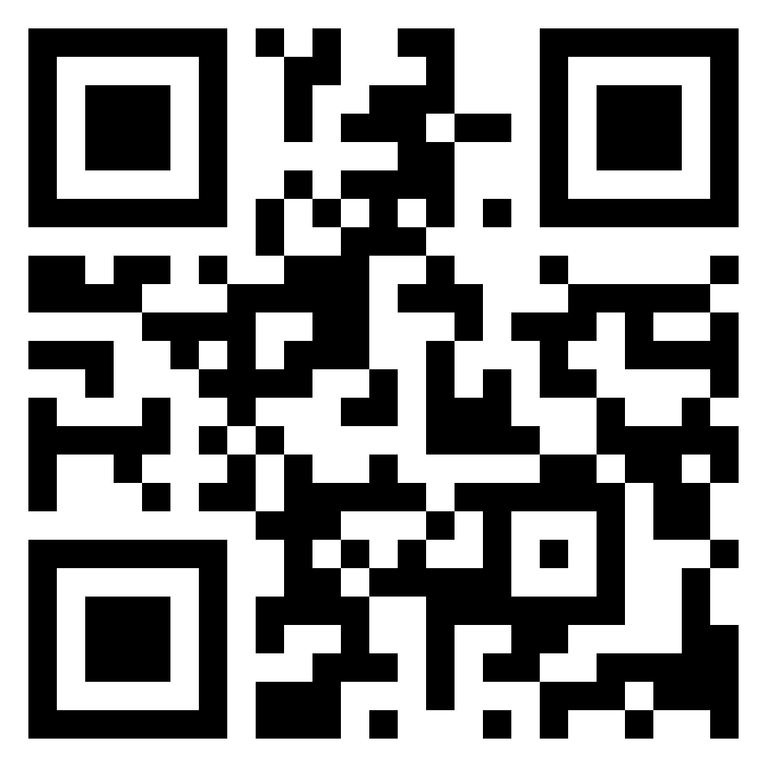
a
THANK YOU
Book time to speak with Tanya using the QR Code below

