Slide 1
February
Roundtable
a
Notes:
Thank you Erin and good morning everyone.
I'm looking forward to spending an hour with you going over our business trend survey.
With me today is our compensation expert Michael matkovich and our employee engagement expert Tanya Zion.
Mikey and Tanya will be joining me to give some insight to submit the survey results and how it lines up with what they are seeing first hand out in the field
Before we get started I have a few slides I would like to share that might give you something to think about as you're digesting this information these slides come from the United Nations data and help make sense when coupled with the results of the survey.
So lets get started.
The 2024 National Business Trends Survey provides detailed information regarding how
executives have responded in 2023 and how they are planning to respond in 2024 to the
changing business climate.
This report includes 1,049 distinct participating organizations spread out over all 50 states,
and Washington D.C. Many survey participants indicated they have business operations in
multiple states.

Slide 2
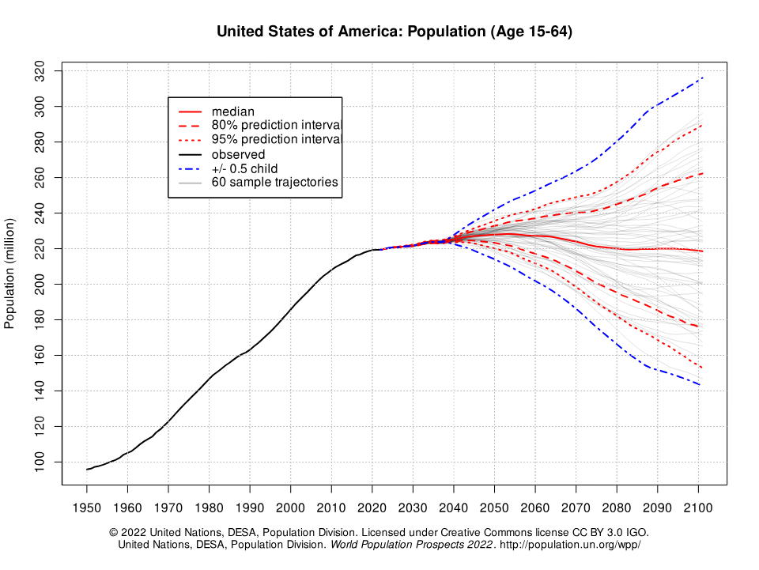
2024
2040
United States
Population
(Age 15-64)
Transitioning from 60 consecutive years of annual population growth of approximately 2,000,000 people to an increase of 250,000 people per year for the next 20 years (120 million vs. 5 million)
a
Notes:
5 MILLION OVER THEXT 20 YEARS THAT IS 250k / YEAR
If everything is equal and you divide that number by 50 states each state would get 5000 additional people / year
Now divide that by the number of counties in each state the increase each county should expect to see based on this projection
For Missouri 44
Illinois 49
Indiana 54
Florida 74
That’s not enough people. Keep in mind they will be 15 years old?

Slide 3
When executives were asked what they believe are the
greatest challenges to their business in 2024
Top 5 Responses | National Weighted Score
Talent Acquisition | 1167
Talent Retention | 756
Ability to pay competitive wages and salary | 641
Competition in general | 536
Cost of materials | 755
Bottom 3 Responses | National Weighted Score
A.I. technology and platforms | 38
Work from home/remote work/hybrid | 38
Advancing diversity, equity, and inclusion | 35
a
Notes:
Executives answered 42 questions in this survey and im going to focus on the most significant results and trends.
So what do executives believe are their greatest challenges to their business in 2024 (Executives had 25 options to select from).
As you can see here leading the way as it did last year, is talent acquisition it is almost double their next concern (talent retention).
Talent acquisition also led the way last year which should come as no surprise when we consider the demographic slides around our working age population and the flattening that has occurred and will continue for the next 20 years.
The question for us to ask is how do we position our business to get out in front of this challenge and not be handicapped by it! The answer to that lays in the Herzburg satisfiers and motivators.
I find it interesting when we consider the bottom 3 responses. These responses are getting a lot of play in conversation and in the media but rank at the bottom when it comes to their greatest challenges. I'm not suggesting these are not important and they do still need to be managed.

Slide 4
Herzberg Satisfiers
Does your workplace offer a
healthy/pleasant environment?
Is your pay competitive?
Do you have a
safe/secure workplace?
Is the location of your business
accessible/preferable?
Is there continuity/job security
at your business?
Are your employees satisfied
with their professions/industry?
a

Slide 5
Herzberg Motivators
Do your employees feel like they have a purpose because of their job? Do they know their purpose?
Does your company employ quality leaders that create an environment of engagement?
Do your employees have friends/colleagues at work?
Is the employee’s work
interesting/challenging?
Do employees at your business
treat each other with respect & fairness?
Does your company have any recognition/appreciation initiatives?
Do your employees feel like they have autonomy/are involved?
Do your employees feel like they receive communication and are in the know?
a

Slide 6
a
THANK YOU
Phil Brandt
President & CEO, AAIM Employers’ Association
/phil-brandt-b8314213
314-754-0255
phil.brandt@aaimea.org
aaimea.org/this-week-at-work

